Slide 1
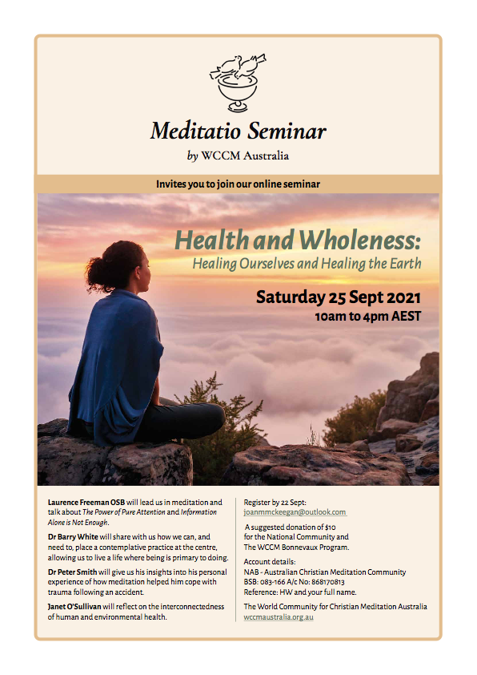

Slide 2
“Health is not just absence
of sickness but a state of physical,
mental and social well being”
World Health Organisation

Slide 3
“We are entering the 3rd stage of practical works of compassion and prophecy arising among meditators when we must address every dimension of being if we are to be equipped to change the world for the better.”
Laurence Freeman

Slide 4
“When the earth is sick and polluted, human health is impossible… to heal ourselves we must heal the planet and to heal the planet we must heal ourselves.”
Bobby McLeod, song writer, activist, Indigenous cultural leader

Slide 5
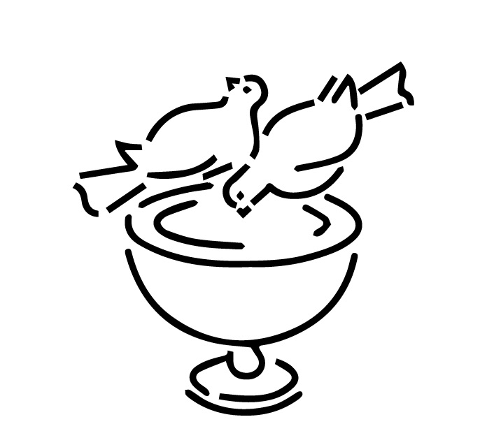
“To transform the world we must first transform ourselves”
Laurence Freeman

Slide 6
The way of meditation
Stillness
Balance
Inner harmony

Slide 7
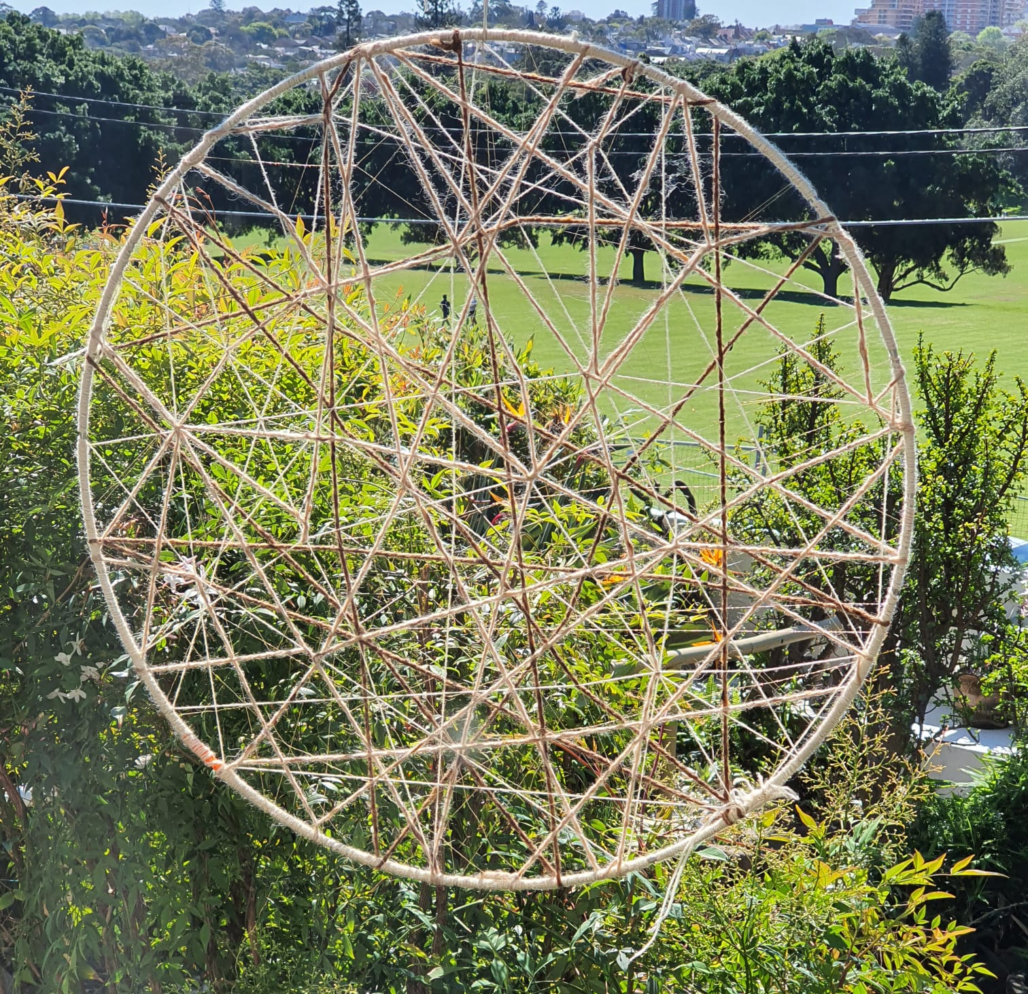
Interconnectedness

Slide 8
OIKOS
Economics
Ecology
OIKOS
Ecumenism
Oikos: Greek “Household”

Slide 9
Words derived from OIKOS
ECOLOGY (oikologia)...the study of the interrelationships of the planetary household
ECONOMY (oikonomia)…household management
ECUMENISM (oikoumenē)...the management of the household’s moral, ethical and spiritual resources amidst a plurality of values

Slide 10
“The earth is dying from the ravages of our materialistic cultures which pollute the air we breath, the water we drink and starve our inner being of the natural connection to the sacred”
Chief Seattle

Slide 11
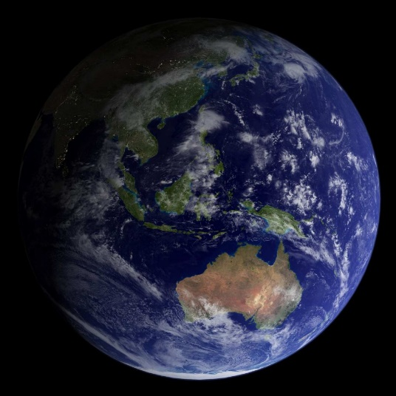
If everyone on the planet used as much energy as Australians, we would need four earths

Slide 12
Tipping points
“radical insights into the present structure of things in terms of the greater truth”
Laurence Freeman

Slide 13
Contemplation and action
Consciousness and conscience
Attention and intention
Ability to respond...response-able

Slide 14
“Conscience has been described in the Orthodox tradition as the seed of divine life within us… and our path there is ‘divinization’ – the full development of this divine potential….which has been implanted in us as a living seed (not written in stone), in order that we can grow into fullness of life.”
Reflections from St Anthony, 13C

Slide 15
“…leading us into the centre of our own hearts...the fullness of love
‘the pearl of great price’…hidden within us…the divine life within us. How do we reflect God’s love and beauty?”
Reflections from St Anthony, 13C

Slide 16
Conscience relates to our ability to respond… to serve… where am I being called to respond to help heal the health of the earth?
Question for reflection

